Slide 1


K.RAMAKRISHNAN COLLEGE OF TECHNOLOGY
(AUTONOMOUS), TRICHY.
DEPARTMENT OF
COMPUTER SCIENCE AND ENGINEERING
20CS5501 DESIGN PROJECT-1
Batch No. : 02
Date : 05.12.2024

Slide 2
LEAF DISEASE DETECTION USING DEEP LEARNING
Guided by Team
Mrs.Valli Priyadharshini.K M.E.,(Ph.D.,) Abinaya P (811722104003)
Assistant Professor, CSE Charumathi P (811722104024)
Jai Pradha S (811722104159)

Slide 3
OBJECTIVE OF THE PROJECT
To create a deep learning-based solution for the accurate detection of diseases in plant leaves.
After identifying diseases, the system will provide tailored remedies to address the specific issues detected.
Furthermore, the project will focus on promoting better crop maintenance practices by providing preventive measures to minimize future outbreaks.
By empowering farmers with actionable insights, the system will help enhance crop resilience and overall productivity.

Slide 4
ABSTRACT
This project uses a Convolutional Neural Network (CNN) to detect diseases in plant leaves, helping farmers identify and address crop issues early. The model is trained on images of healthy and diseased leaves to classify common plant diseases accurately. When a disease is detected, the system suggests remedies, and provides tips on crop maintenance to prevent future issues. By combining disease detection with practical advice, this solution aims to improve crop health, yield, and sustainability in farming.

Slide 5
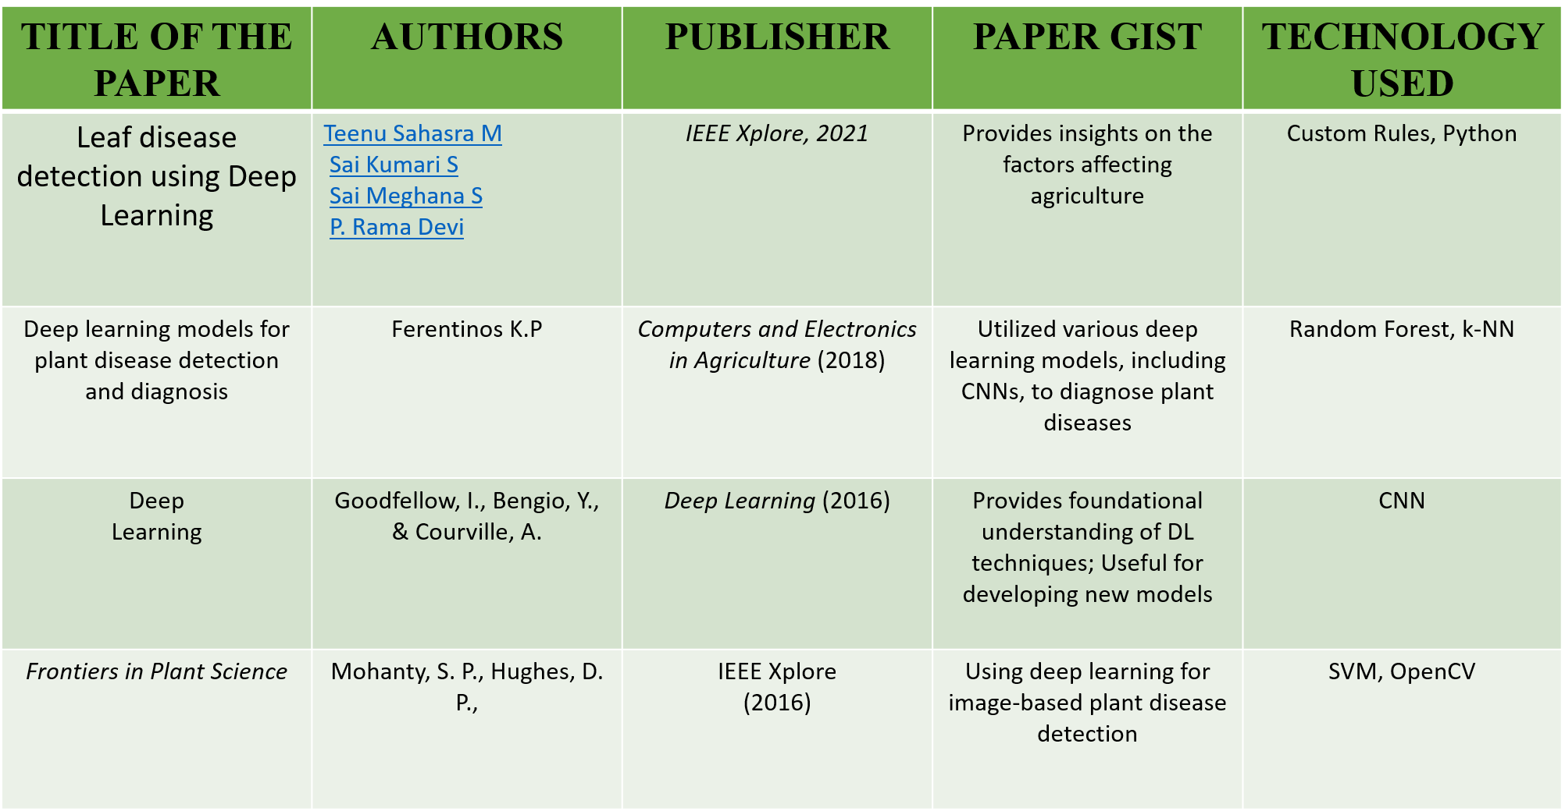
LITERATURE SURVEY

Slide 6
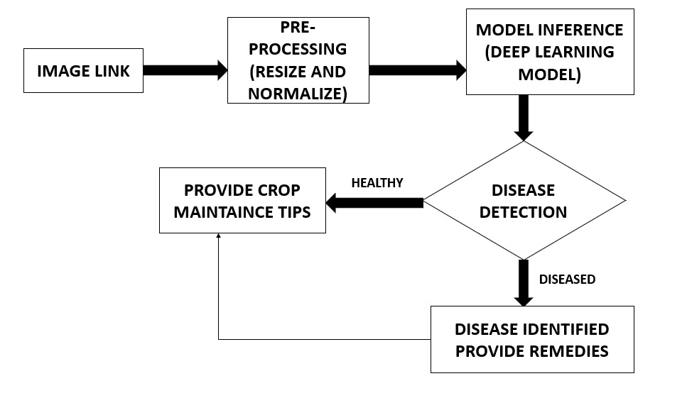
PROPOSED SYSTEM ARCHITECTURE

Slide 7
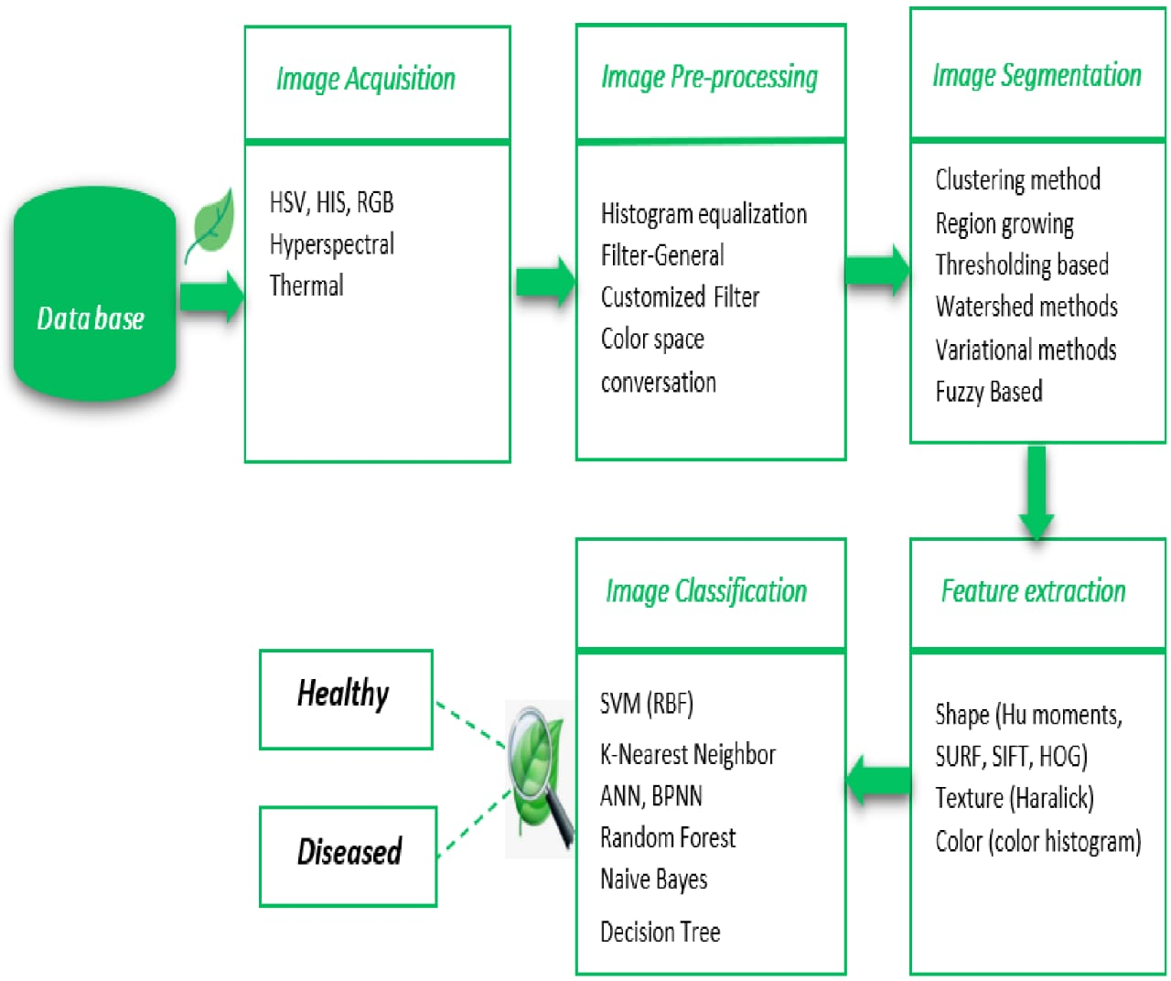
EXISTING SYSTEM ARCHITECTURE

Slide 8
SOFTWARE AND HARDWARE REQUIREMENTS
HARDWARE
SOFTWARE
Operating System: Windows 10 or Higher Coding
Language: Python 3.7.6
Environment Setup : leaf_disease_env\Scripts\activate, python -m venv leaf_disease_env
Platform : Idle
Processor: Intel Core i7
Hard Disk: Not Applicable
Monitor: Responsive to all Screen Sizes (Responsive Design)
RAM: Minimum 2GB

Slide 9
MODULES
Data Collection and Preprocessing
Model Development
User Interface
Ethical Considerations
Deployment and Sustainability

Slide 10
MODULE-1
Data Collection and Preprocessing
Data Collection: Collecting the required data for the datasets(leaf)
Normalization: Scaling pixel values to a specific range for consistent input.
Resizing: Adjusting the image dimensions to a fixed size.
Cropping: Removing unwanted outer areas of an image.
Image Augmentation: Applying transformations like rotation, flipping, or scaling the image
Data Compression: Reducing the size of an image file while retaining essential information.

Slide 11
MODULE-2
Model Development
Dataset Splitting
Divide data into training, validation, and test sets (e.g., 70-20-10 split).
Model Selection
Choose a deep learning architecture (CNN).
Model Design
Define the model architecture using frameworks (TensorFlow).
Use convolutional layers for feature extraction and dense layers for classification.

Slide 12
MODULE-3
User Interface
Input Section
Image Upload : Allow users to upload leaf images (AS A LINK).
Result Display
Prediction Result: Show the disease detected (e.g., "Healthy," "Powdery Mildew," etc.).
Remedy: Gives the remedy for the diseased leaf.
Crop maintenance: Suggestions to maintain the crop health state as good

Slide 13
MODULE-4
Ethical Considerations
Data Privacy: Ensure that any data collected (e.g., images from users) is stored securely and not misused.
Accessibility: Make the technology affordable and easy to use for small-scale farmers.
Transparency: Clearly explain the limitations and workings of the system to users.
Impact on Farmers: Prevent dependency on technology by offering education and support alongside the tool.

Slide 14
MODULE-5
Deployment and Sustainability
System Updates: Regularly update the system to include new diseases, crops, and advancements in deep learning.
Scalability: Build the system to support increasing users, diverse crops, and broader geographic coverage.
Cost Efficiency: Reduce deployment and operational costs to make the technology accessible to small-scale farmers.
User Interface Development: To make a user-friendly platform to upload link of the leaf images and receive disease diagnoses.

Slide 15
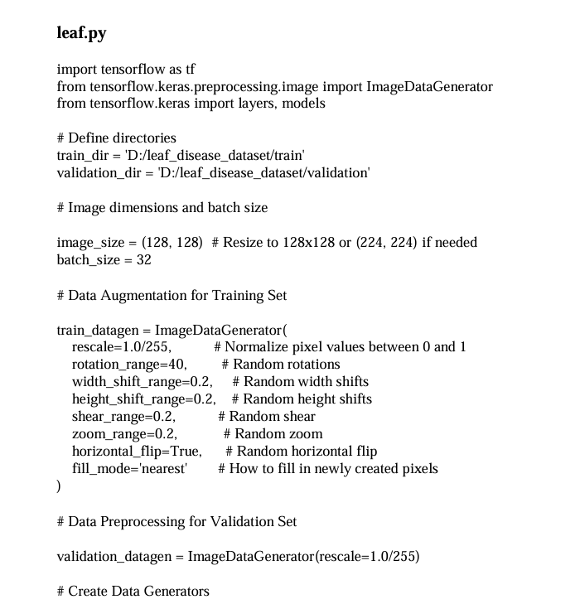
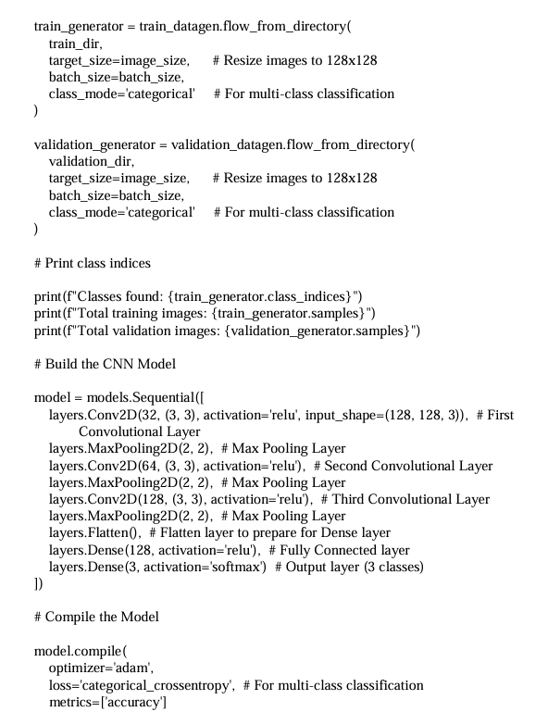
RESULTS AND DISCUSSION (SAMPLE SOURCE CODE)

Slide 16
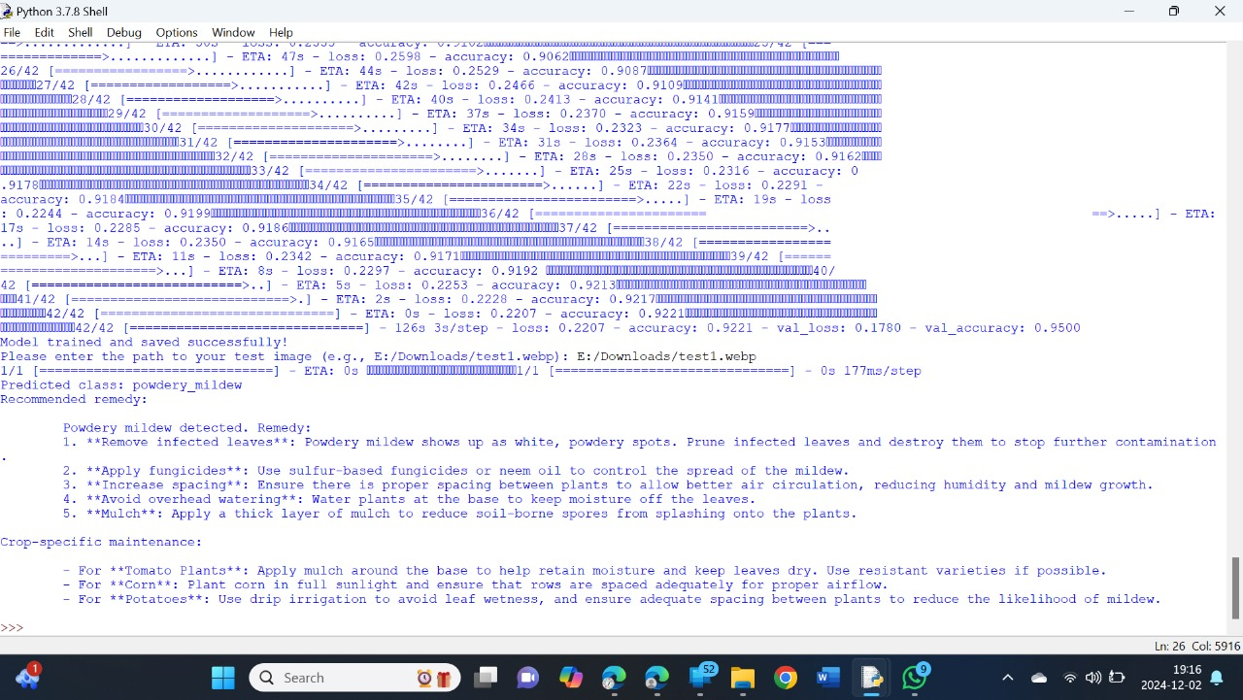
OUTPUT

Slide 17
CONCLUSION
The leaf disease detection system using deep learning proved to be an effective tool for identifying plant diseases with high accuracy and speed. It demonstrated strong potential to assist farmers in diagnosing crop issues, saving time and reducing dependency on agricultural experts. Overall, the project highlights the value of integrating deep learning into agriculture, offering a scalable and cost-effective solution for improving crop health management.

Slide 18
THANK YOU

